Slide 1
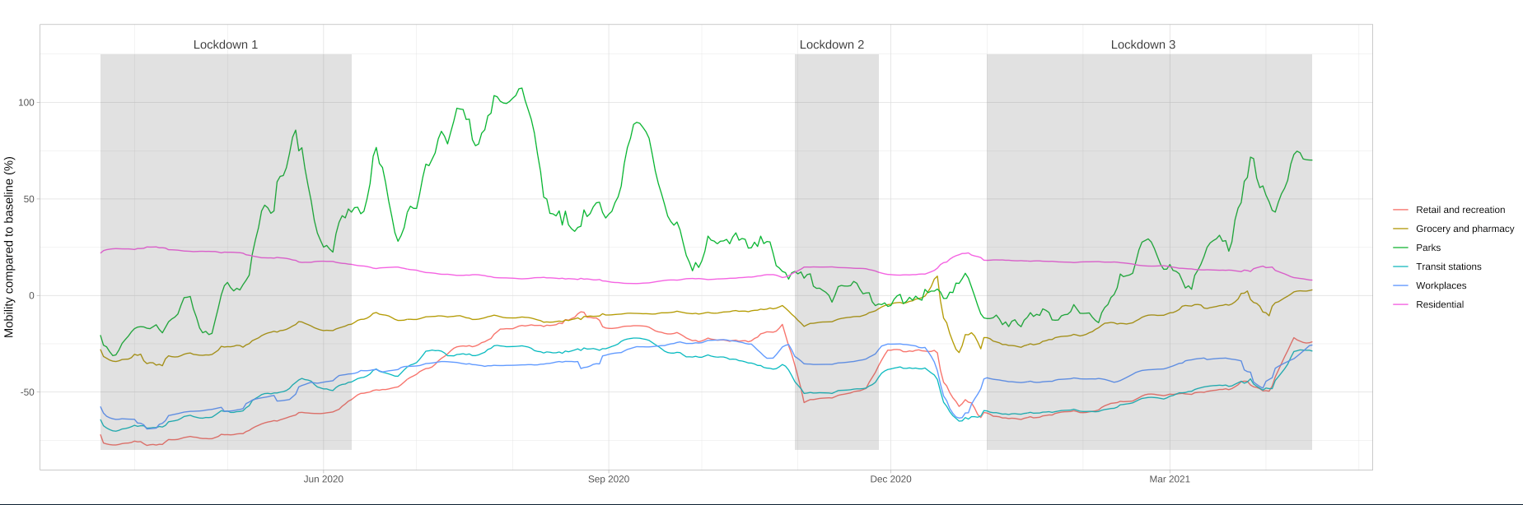
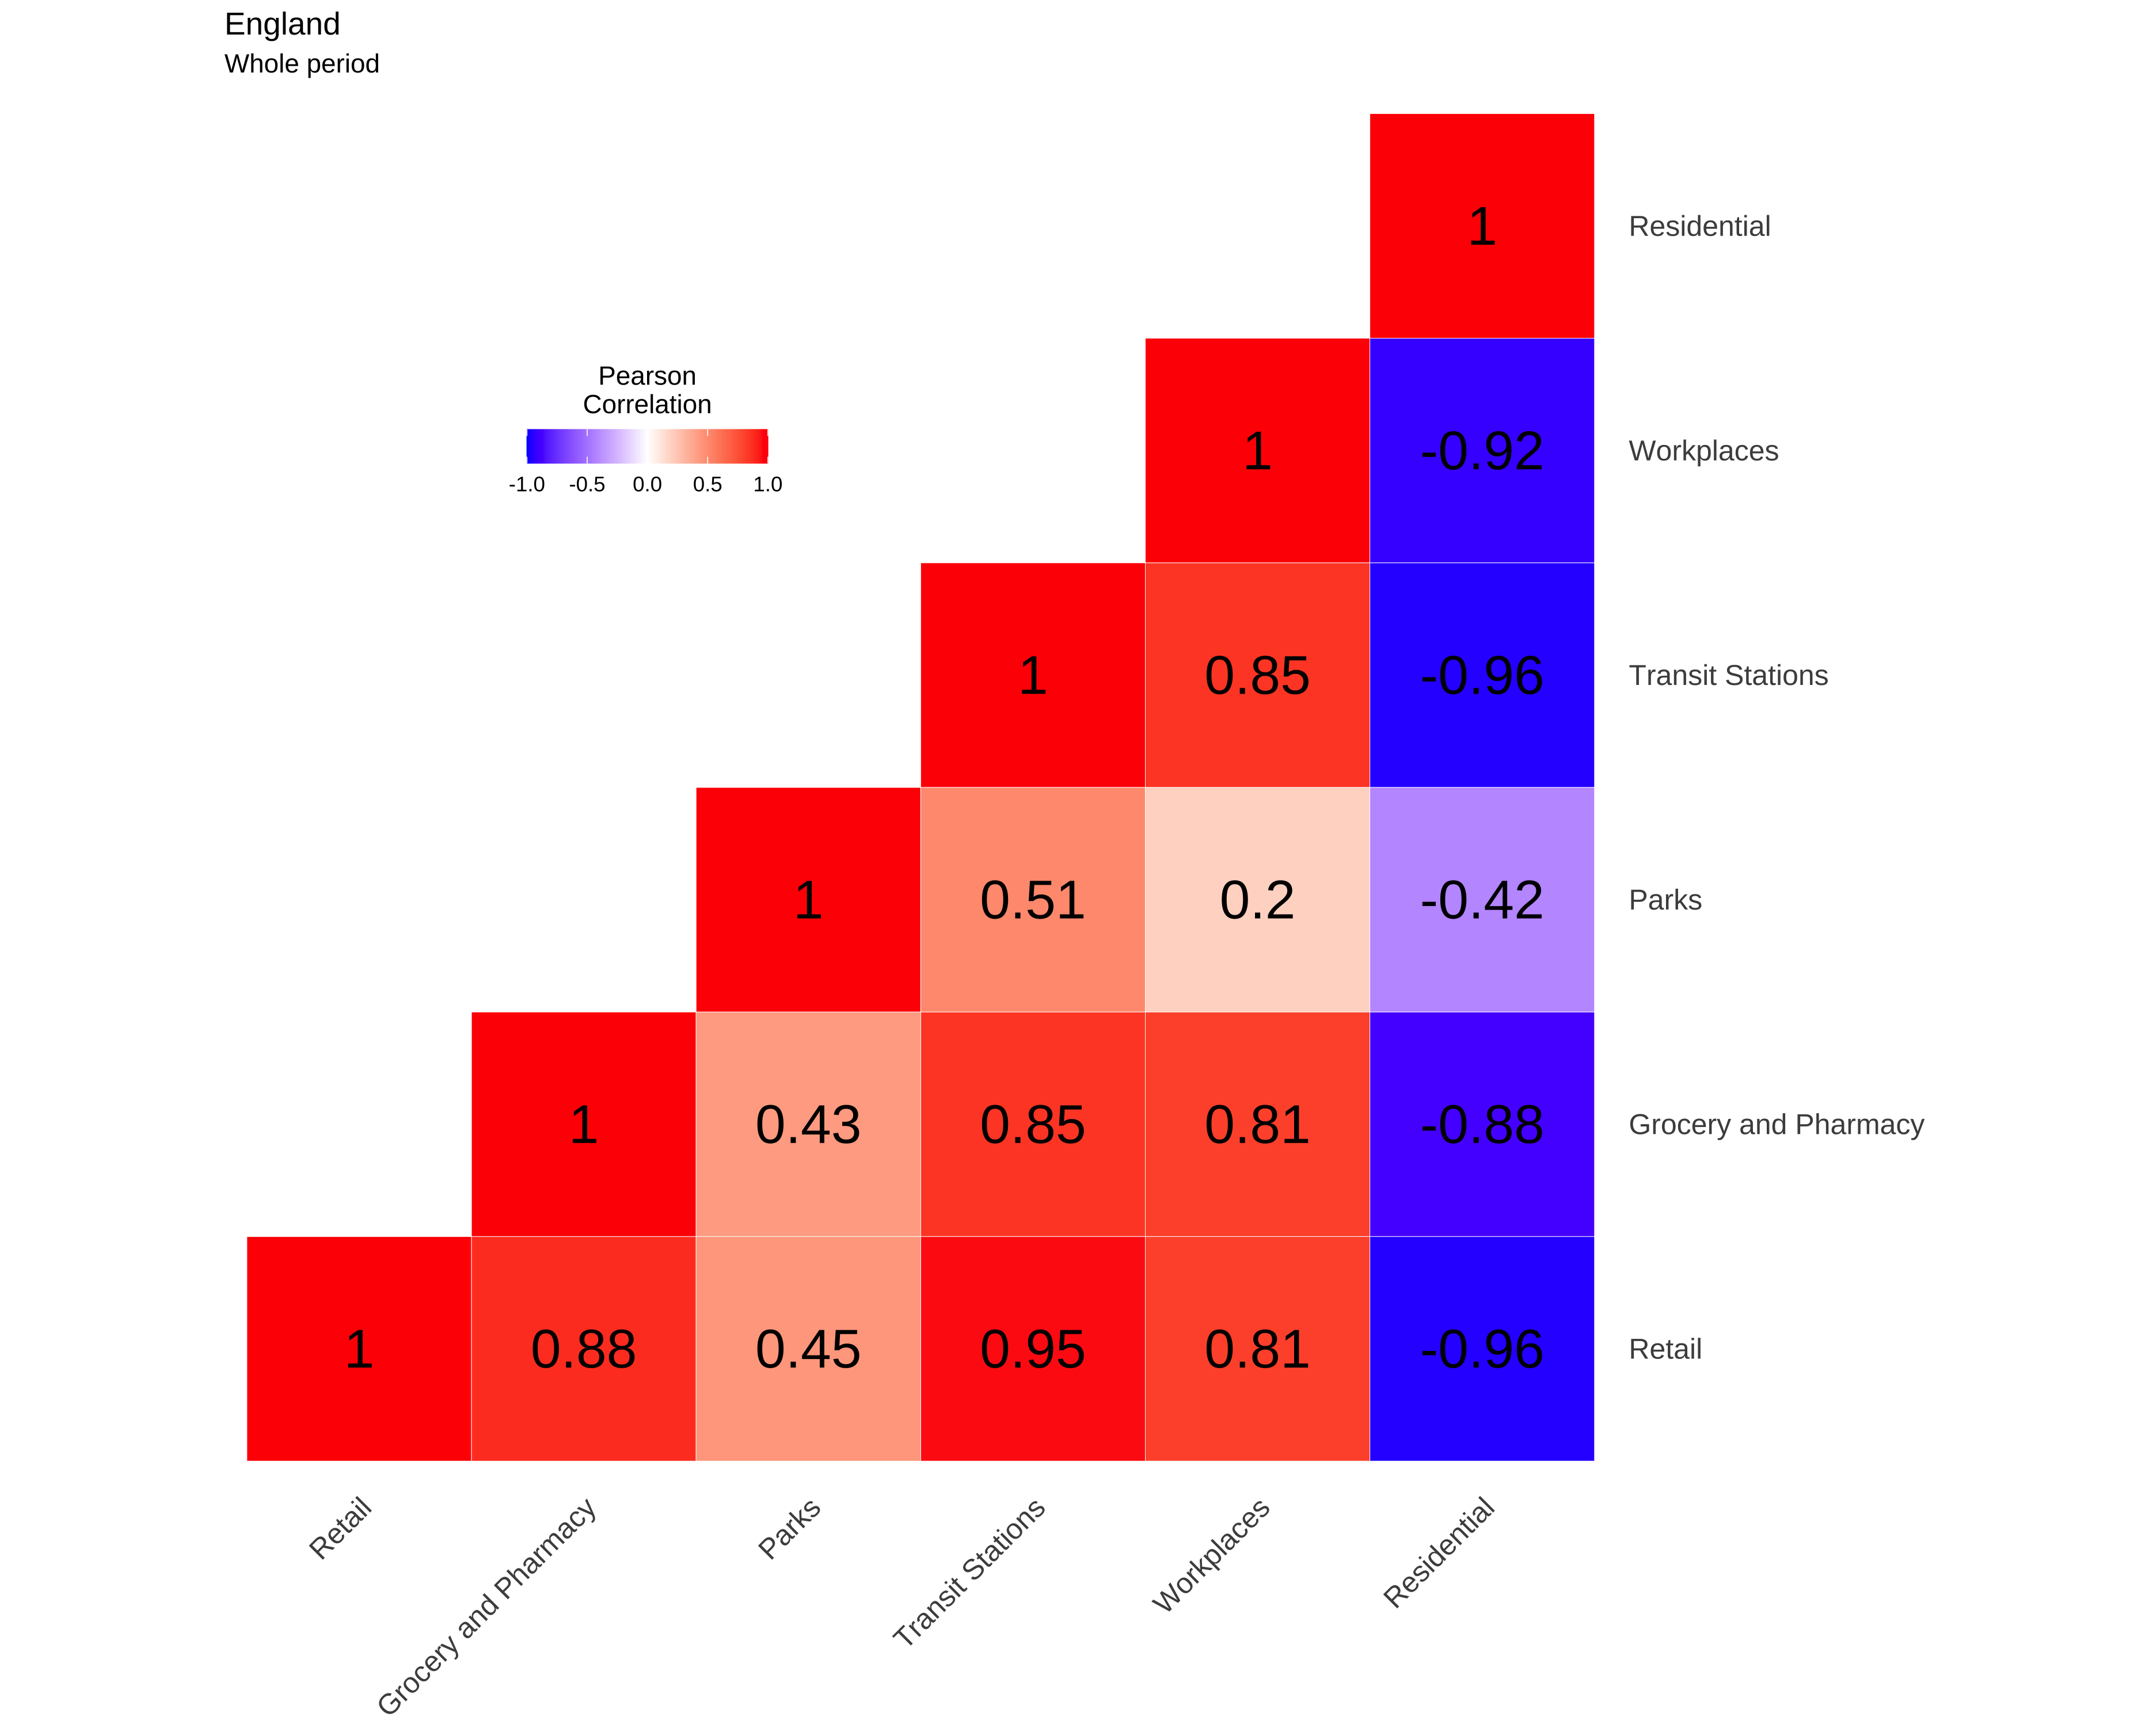
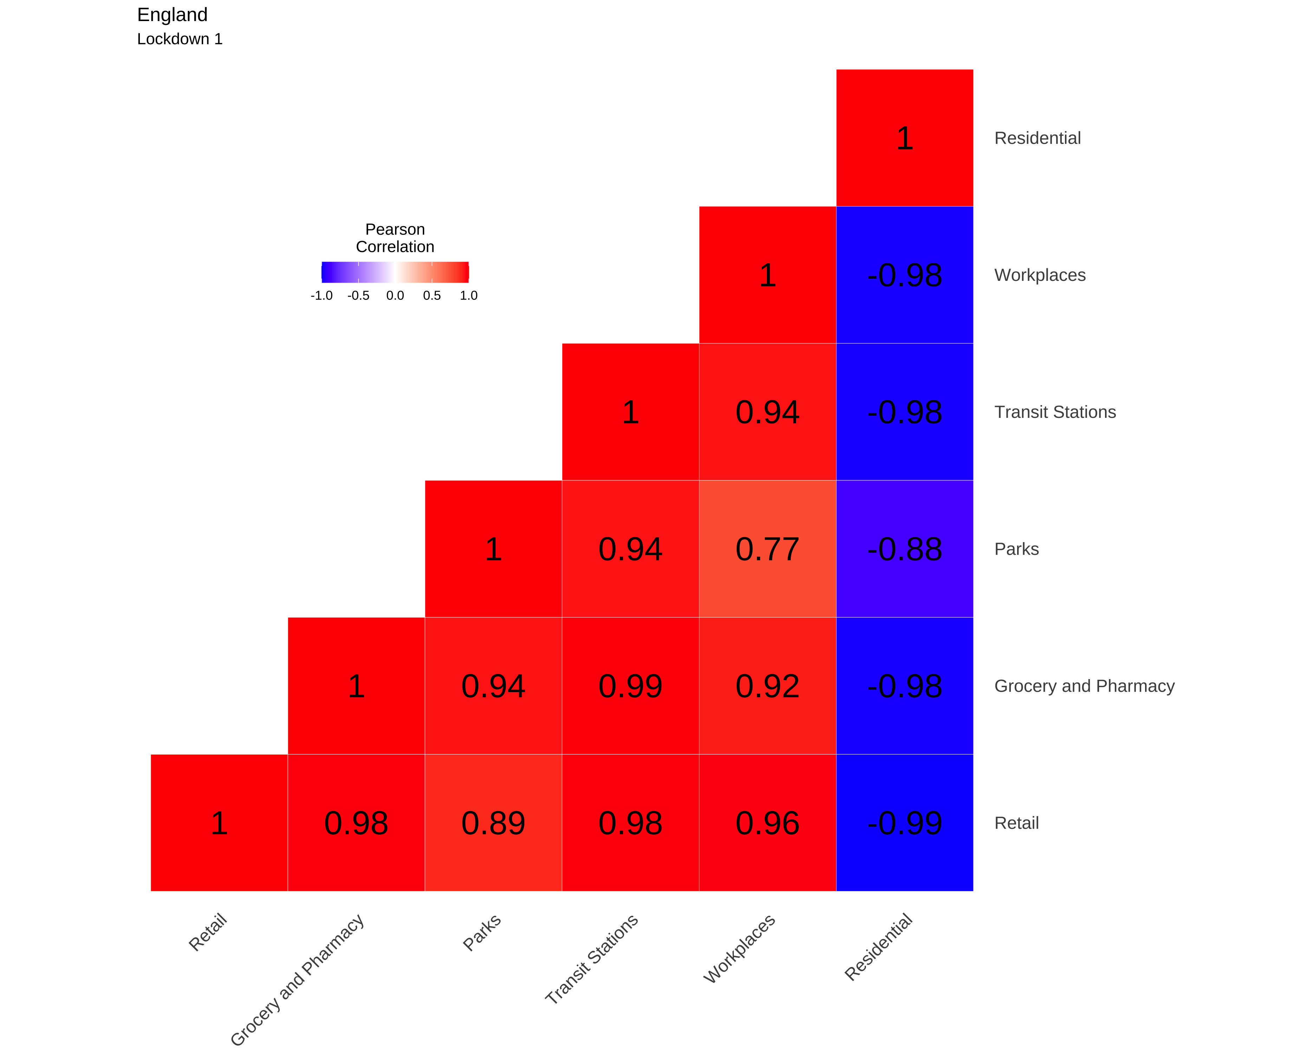
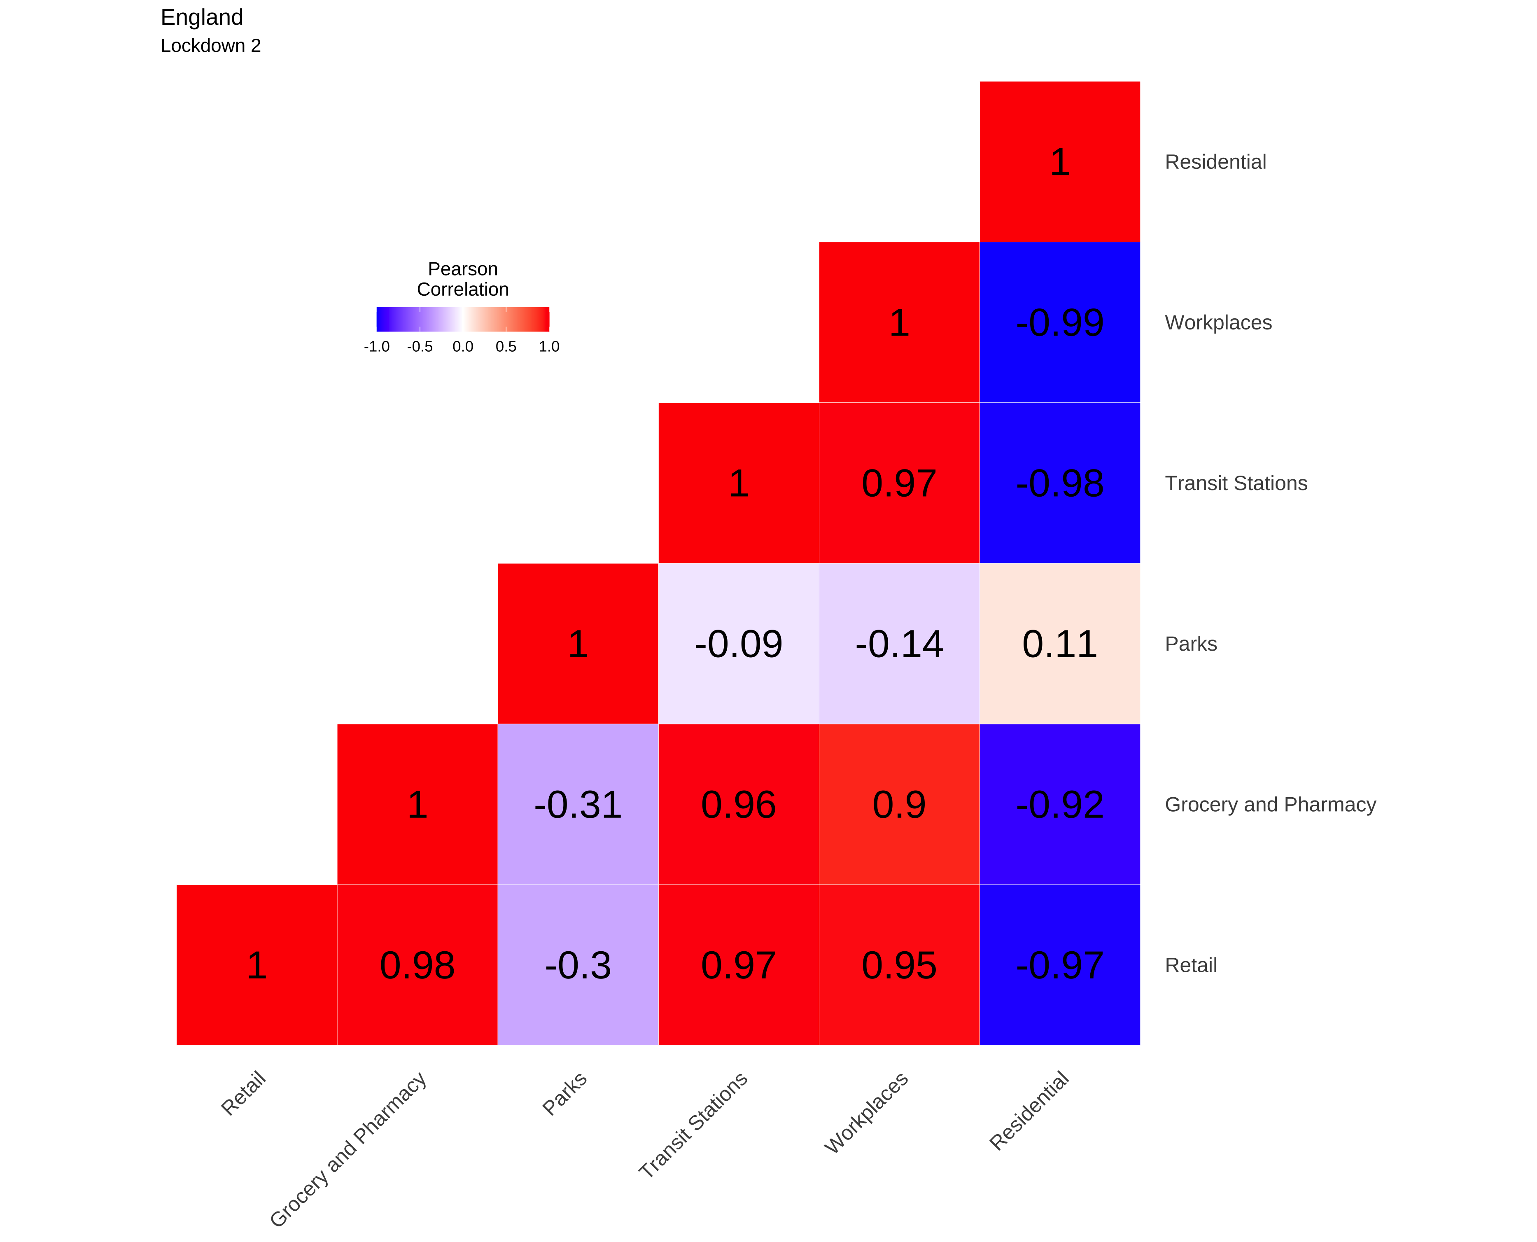

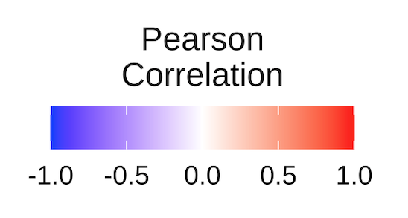
A
B
C
D
E
Whole period
Lockdown 1
Lockdown 2
Lockdown 3
Notes:
This slide has the restricted start date
Line chart from -> Descriptive/8
Correlation heatmaps from -> NPIs_mobility_updated/Outputs/Corr_heatmaps

Slide 2
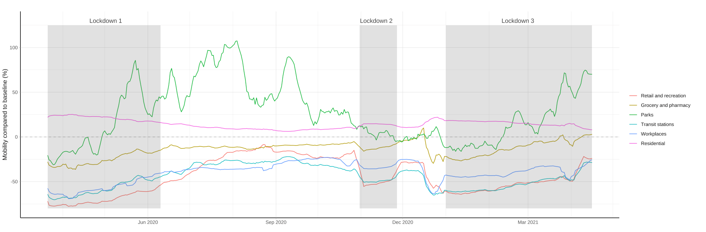
A
B
C
D
E
Whole period
Lockdown 1
Lockdown 2
Lockdown 3
Notes:
This slide has the restricted start date
Line chart from -> Descriptive/8
Correlation heatmaps from -> NPIs_mobility_updated/Outputs/Corr_heatmaps

Slide 3
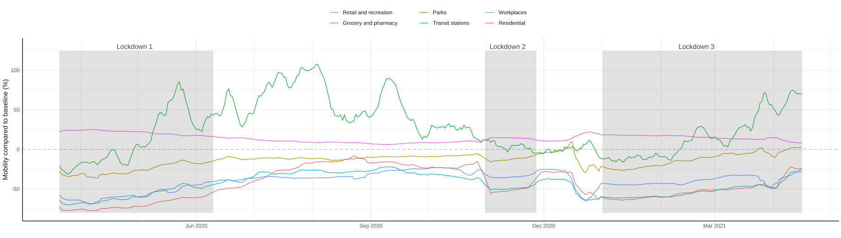
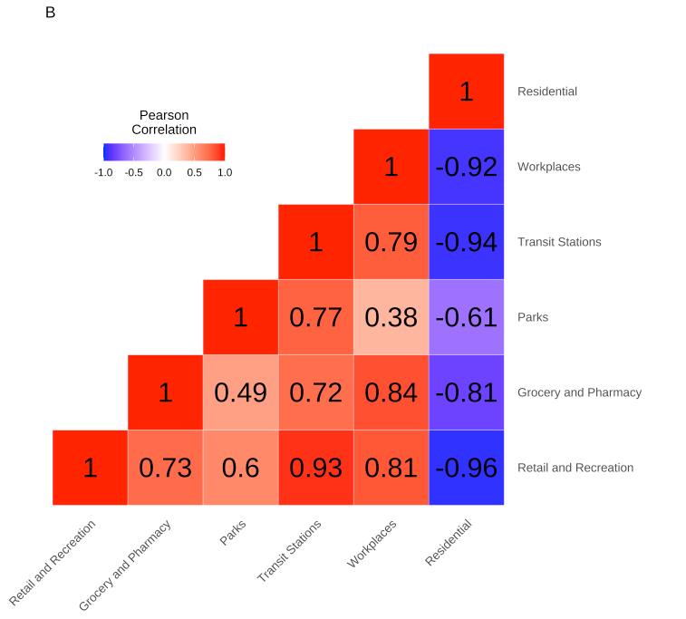
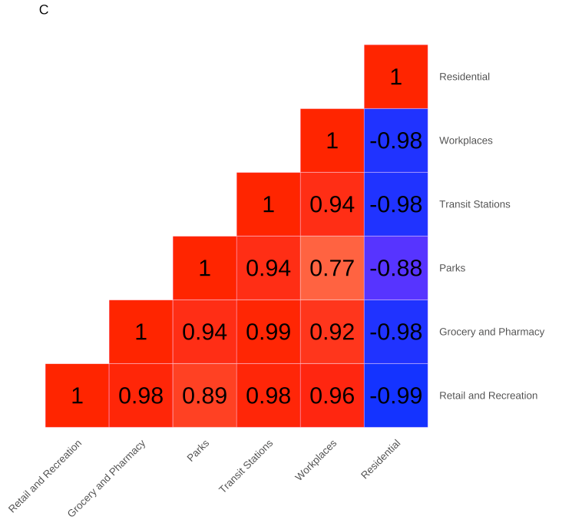
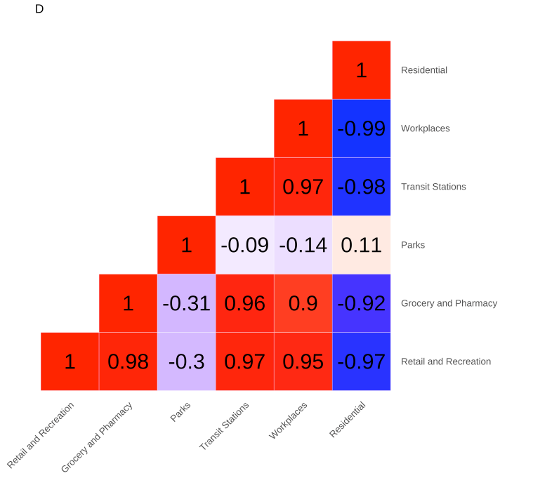
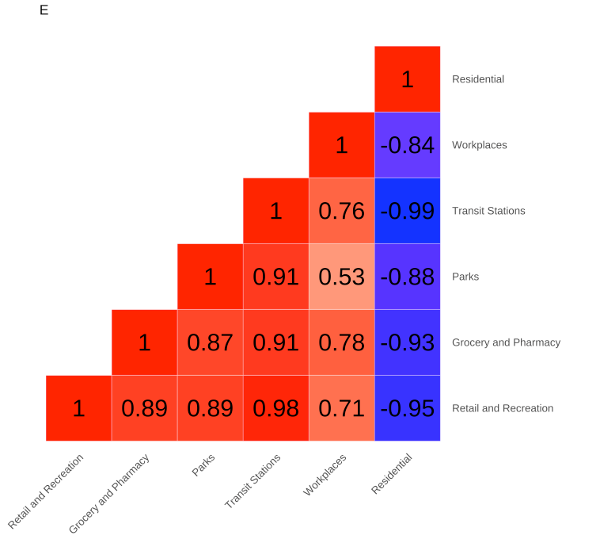
A
B
C
D
E
Whole period
Lockdown 1
Lockdown 2
Lockdown 3
Notes:
This slide has the restricted start date
Line chart from -> Descriptive/8
Correlation heatmaps from -> NPIs_mobility_updated/Outputs/Corr_heatmaps

Slide 4
Whole period
Lockdown 1
Lockdown 2
Lockdown 3

Slide 5
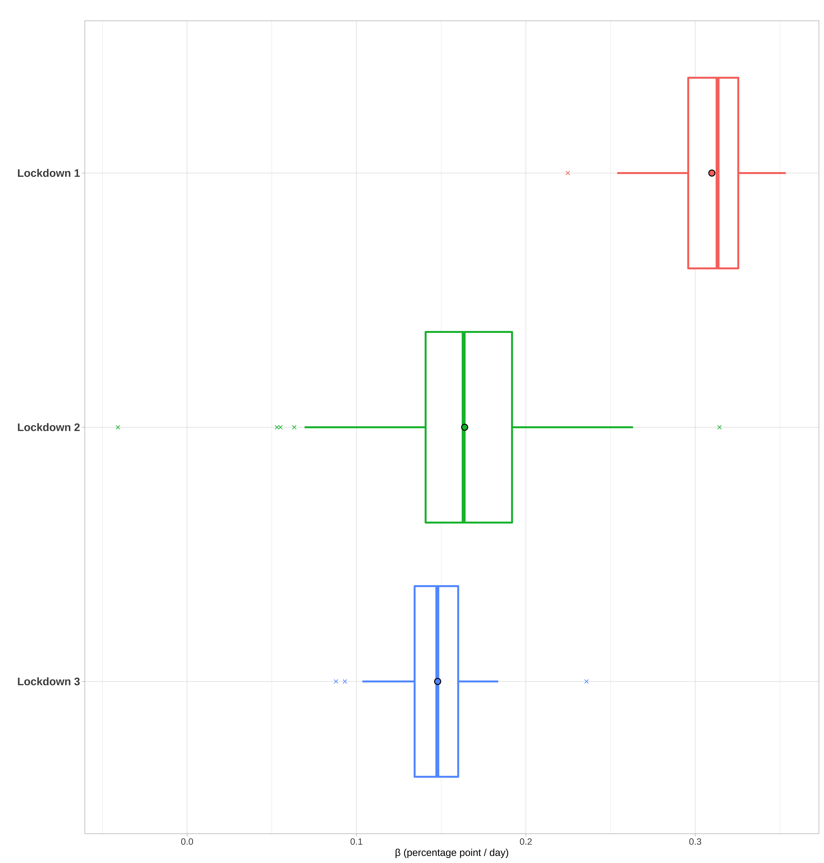
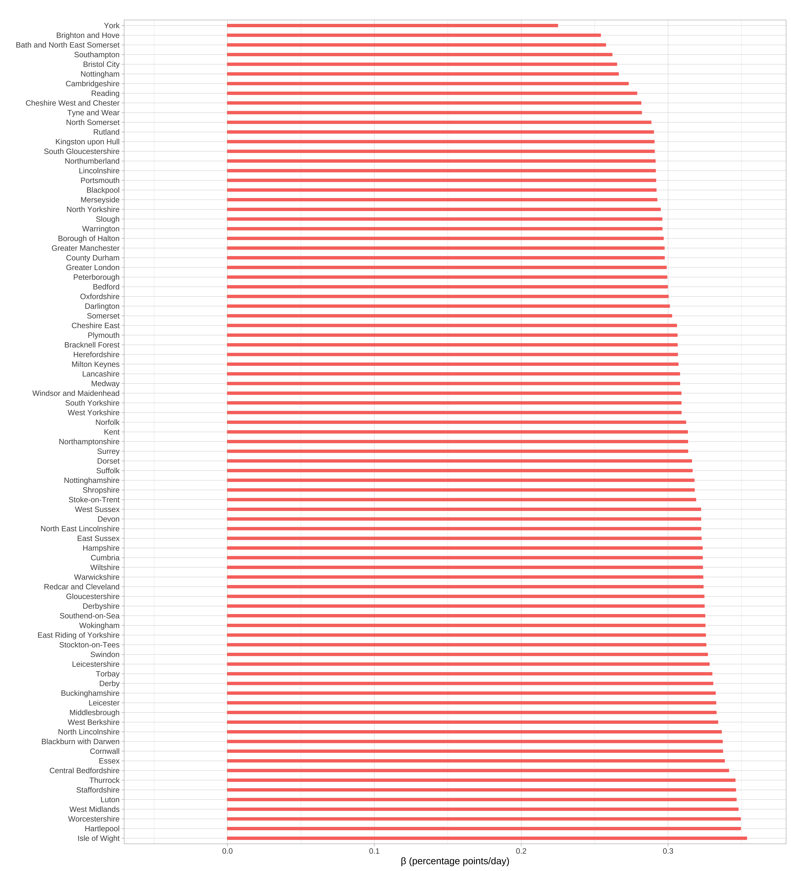
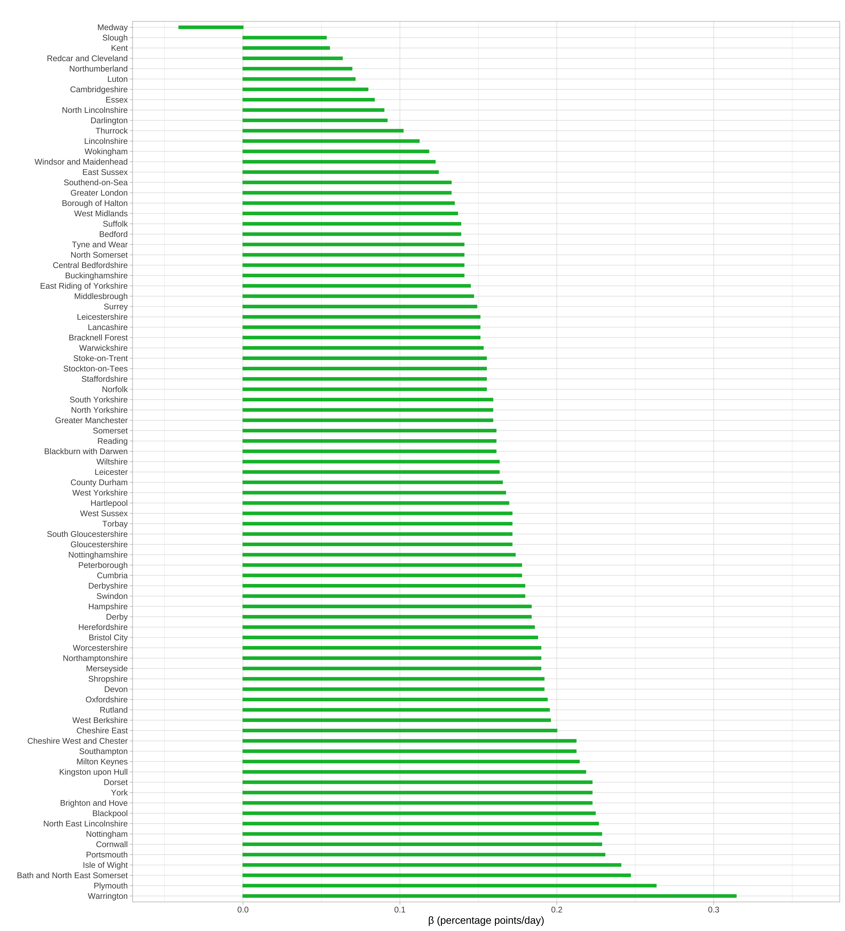
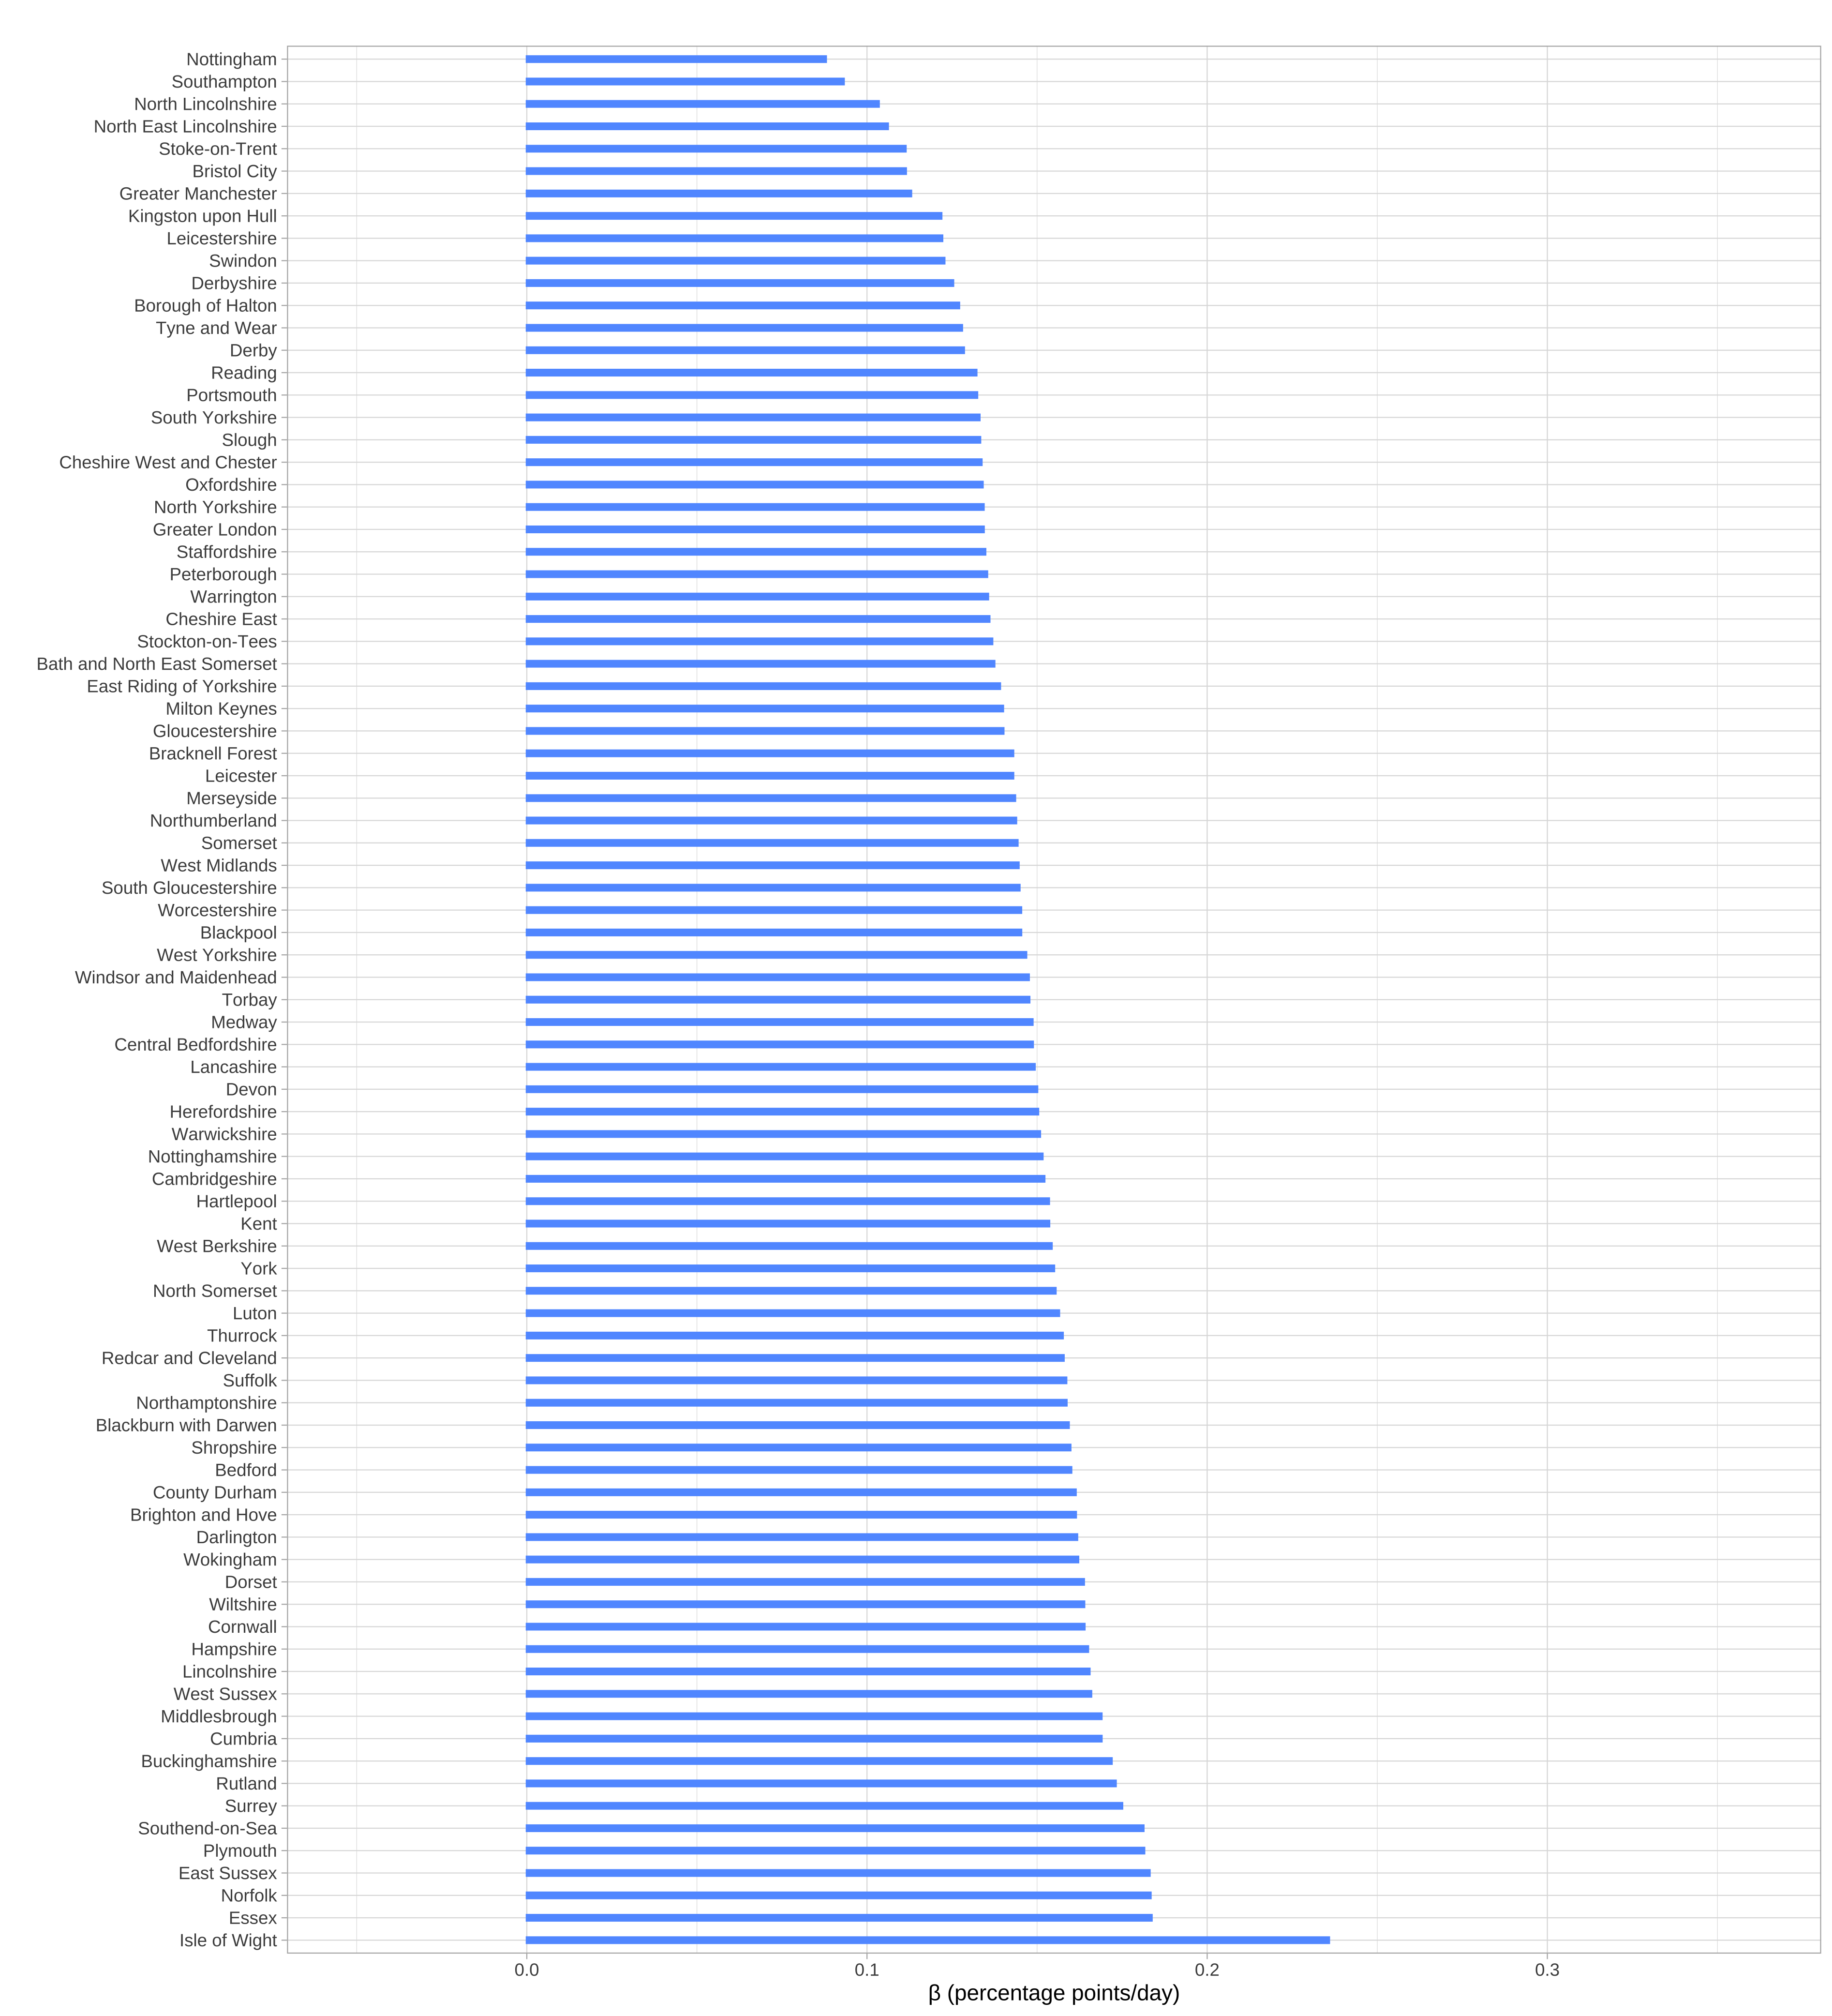
A
B
C
D
Notes:
Plots produced in NPIs_mobility_updated/3_Regression_Visualisation
Saved in …/Outputs/Regression/Plots

Slide 6
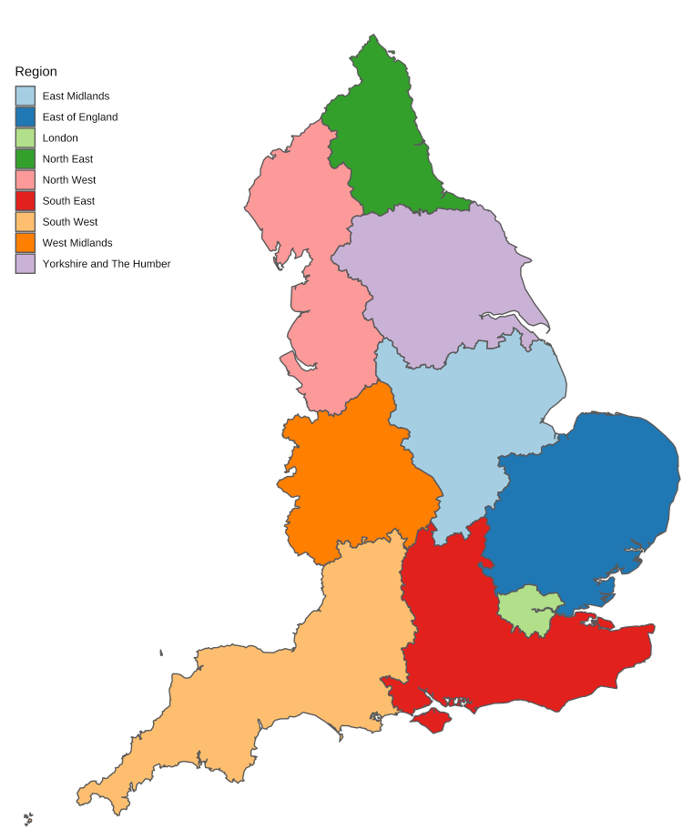
Notes:
Map from Descriptive/7

Slide 7
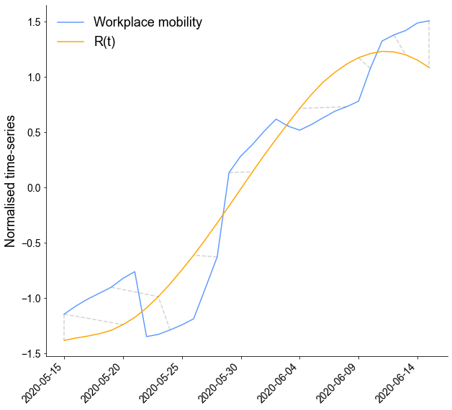
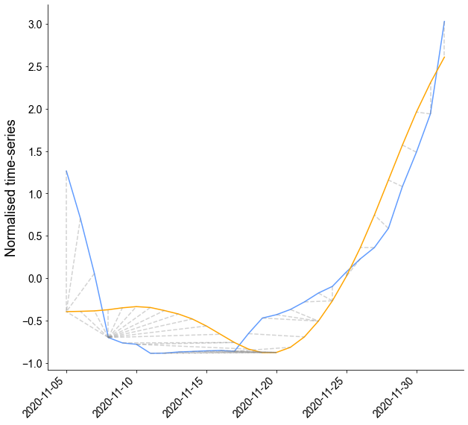
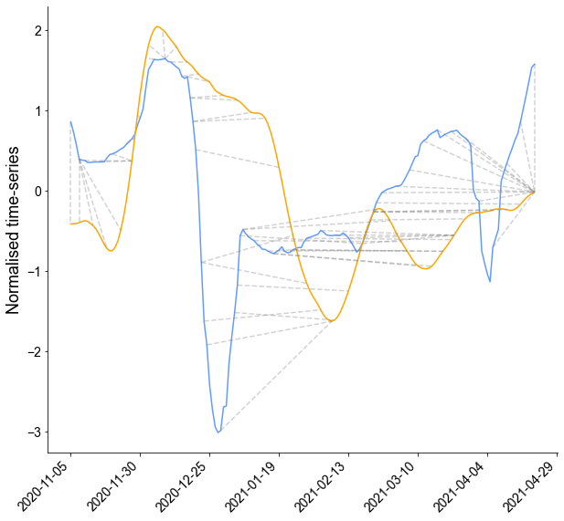
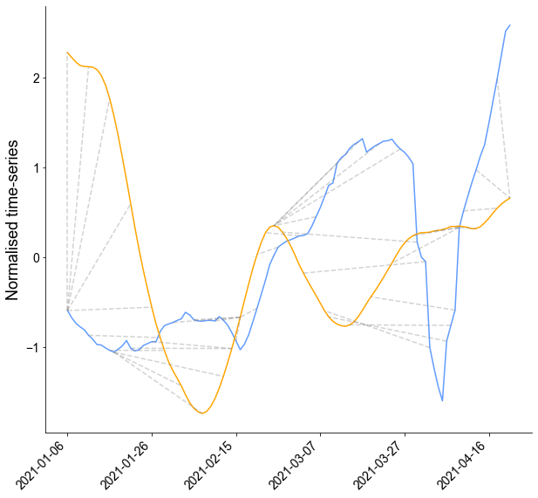
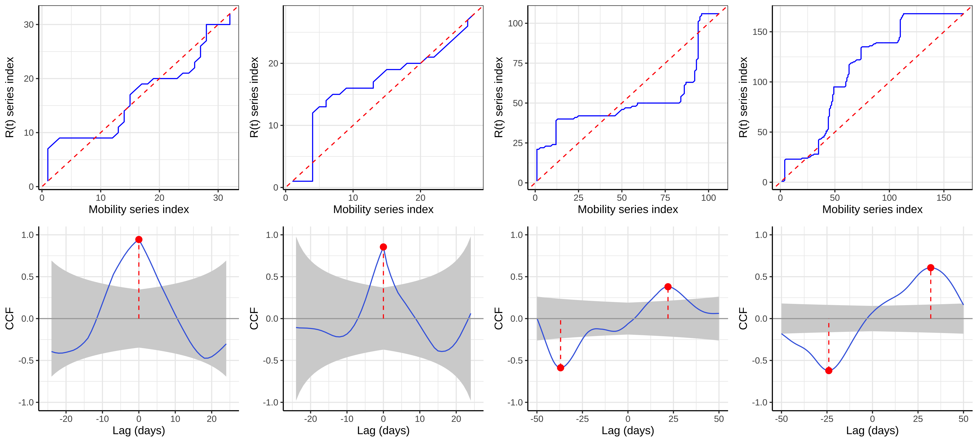
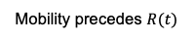
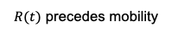
Lockdown 1
Lockdown 2
Lockdown 3
Lockdowns 2-3
A
B
C
D
E
F
G
H
I
$R(t)$ precedes mobility
Mobility precedes $R(t)$

Slide 8
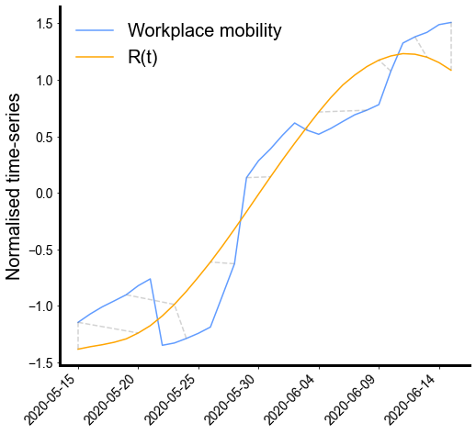
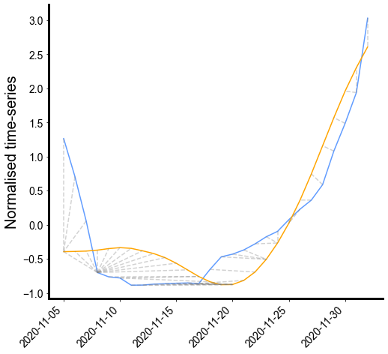
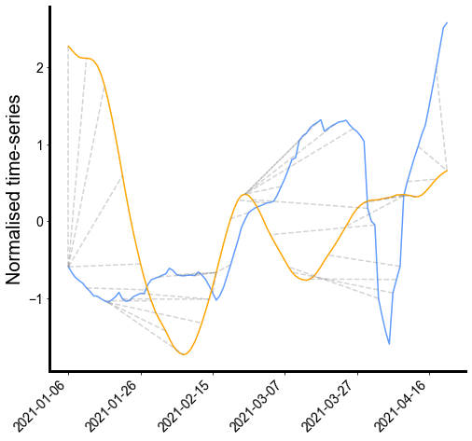
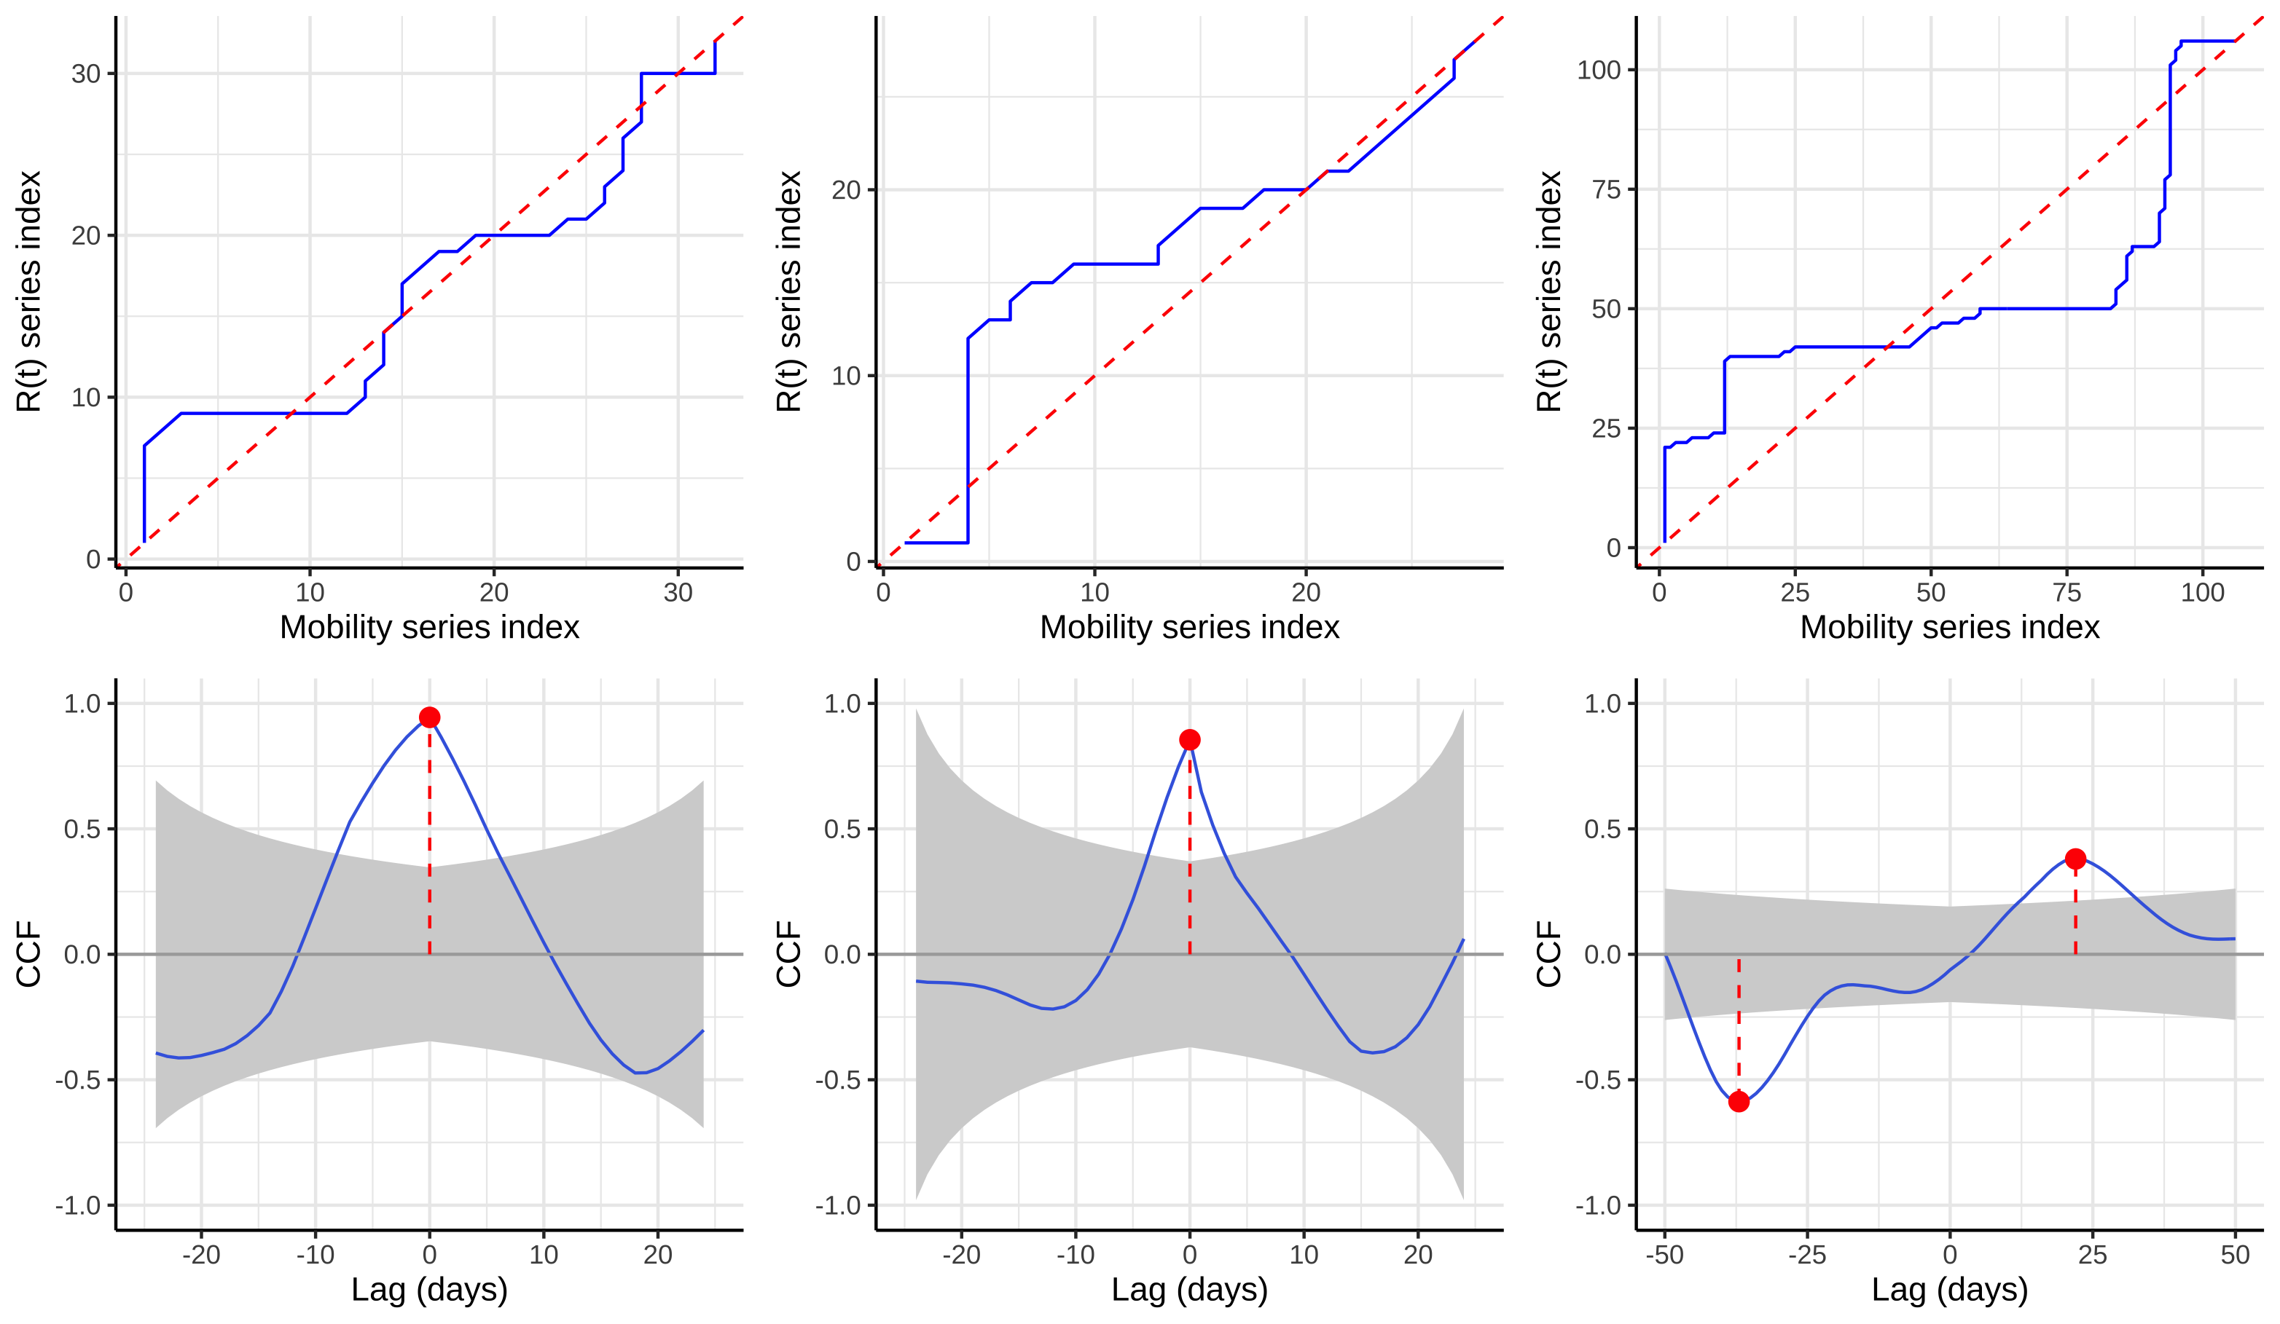
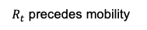
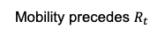
Lockdown 1
Lockdown 2
Lockdown 3
A
B
C
D
E
F
G
H
I
$R_{t}$ precedes mobility
Mobility precedes $R_{t}$

Slide 9
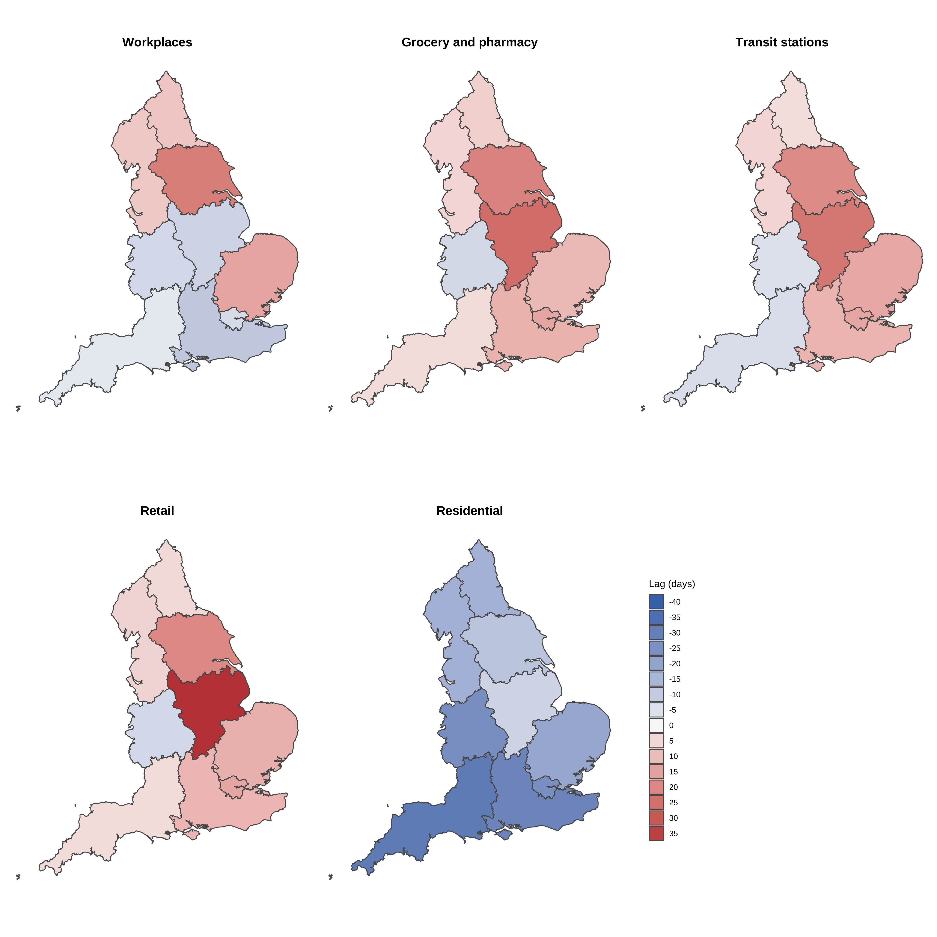
$R_{t }$precedes mobility
Mobility precedes $R_{t}$
Notes:
Lags/outputs/regional/multiplot_dtw_regional
From script lags/3

Slide 10
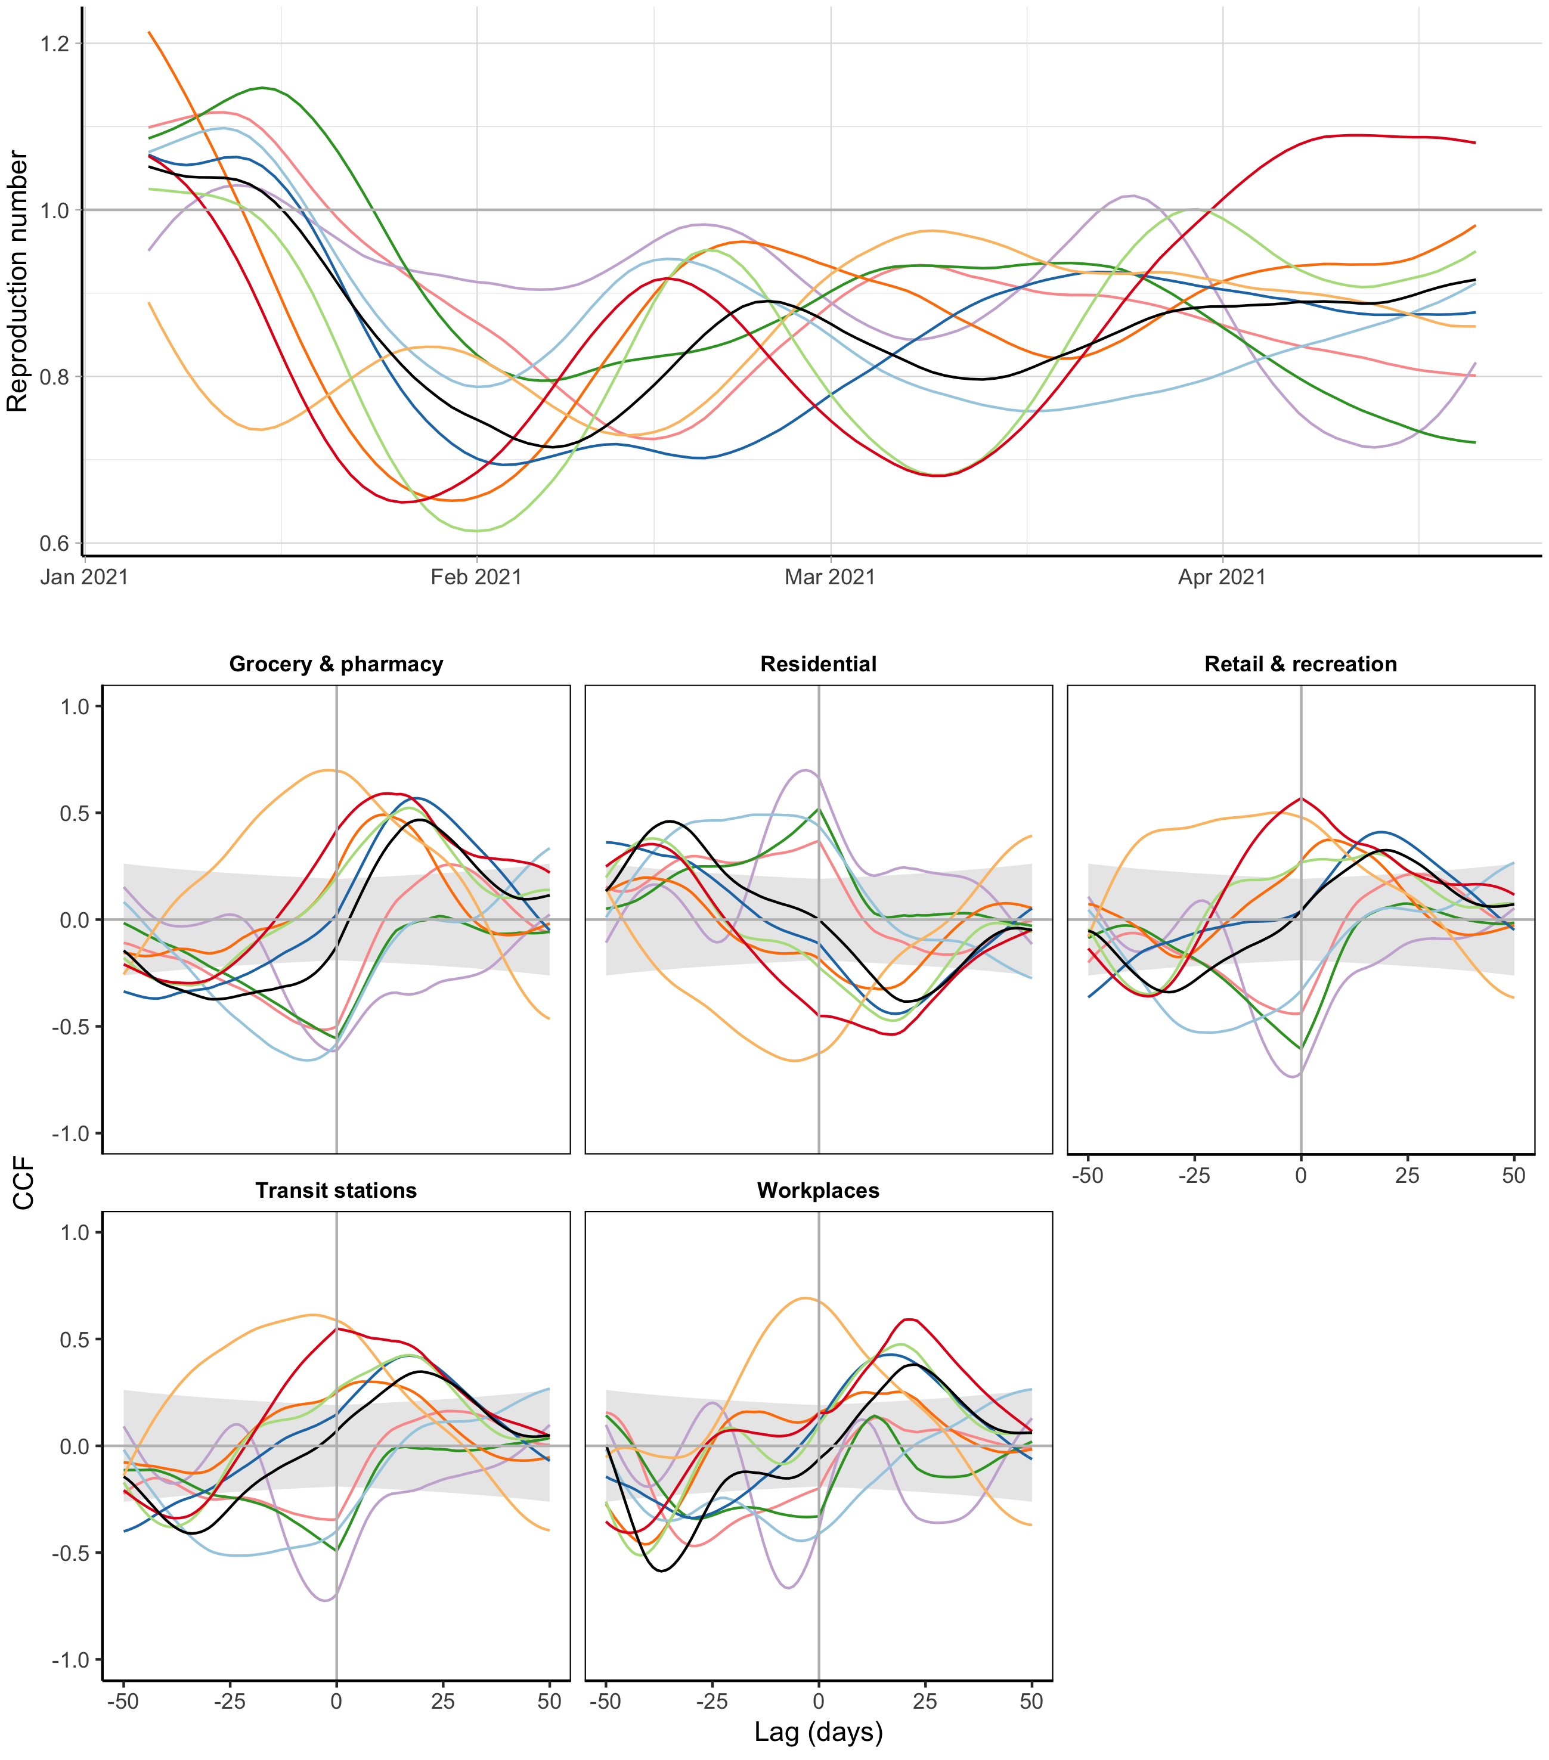
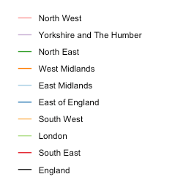

Slide 11


Slide 12
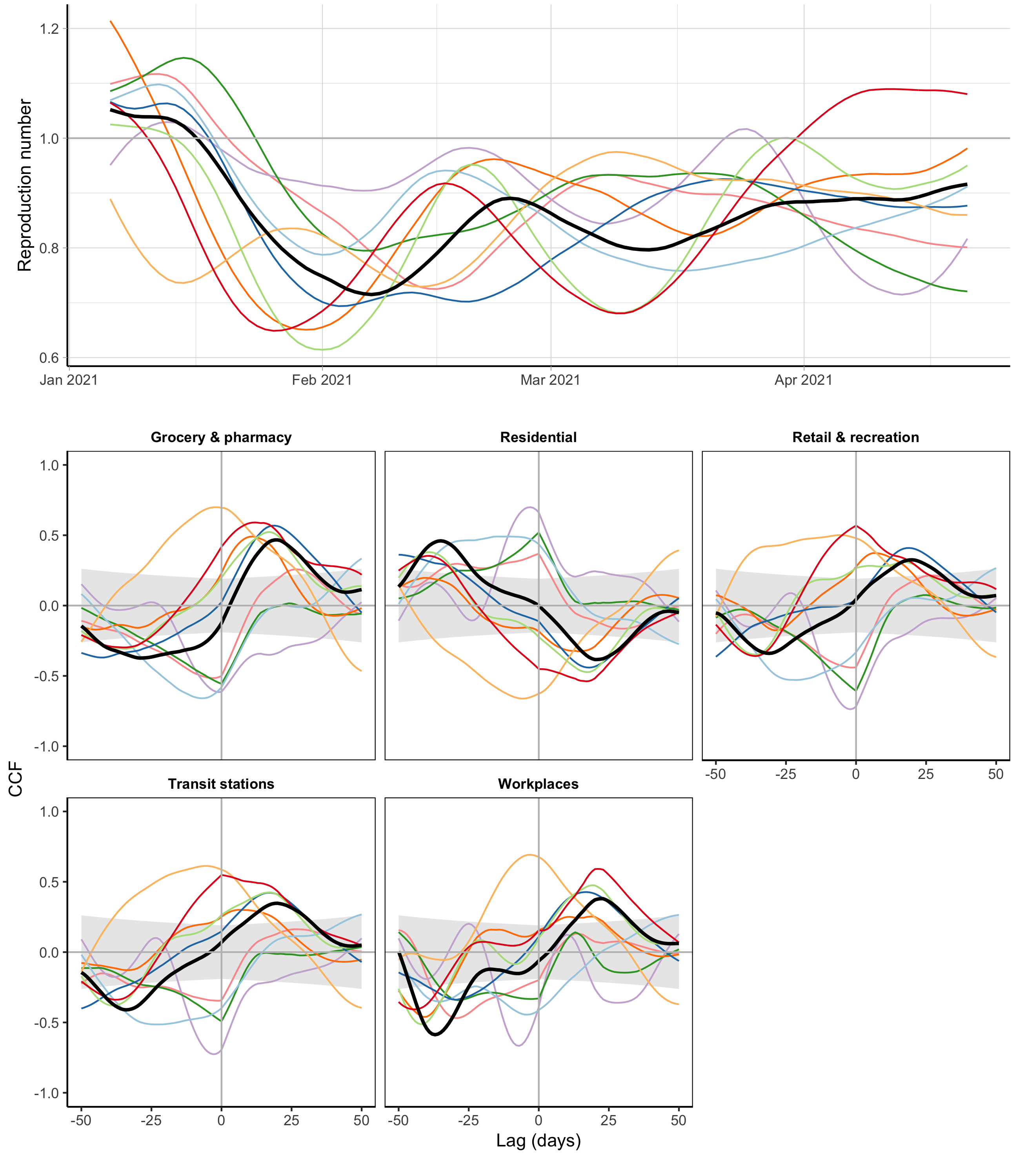
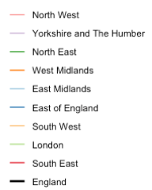
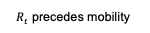
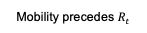
$R_{t}$ precedes mobility
Mobility precedes $R_{t}$

Slide 13
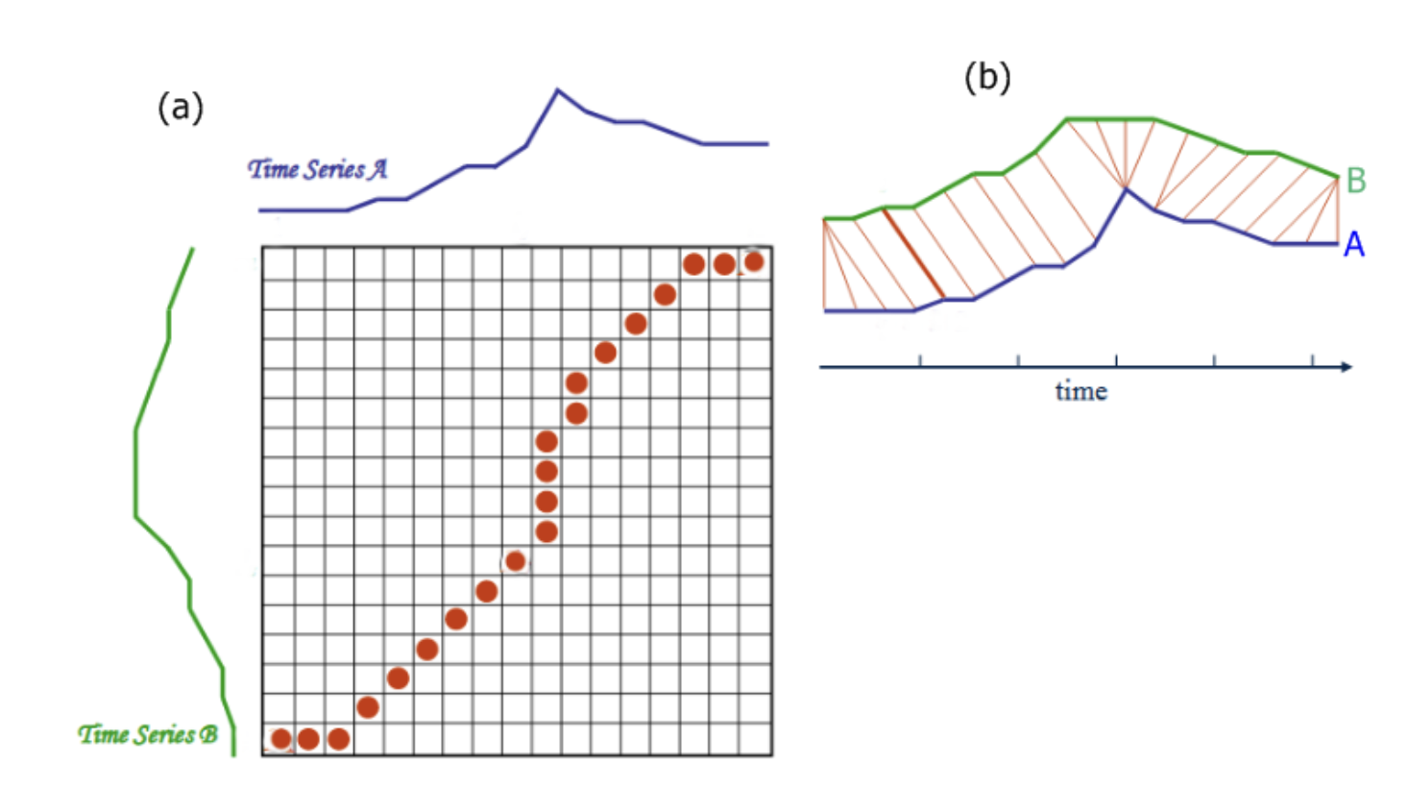
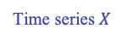
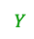

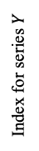
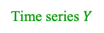
A
B
Time series $X$
M
$$Y$$
$$X$$
Index for series $Y$
Time
1
Time series $Y$
1
N
Index for series X

